Slide 1
AI Course Week 2: Learning ≈ Optimization
Chia-Hui Chang
2022/09/22
Slide sources: Stanford CS-221 by Prof. Finn and Prof. Anari

Slide 2


Join at slido.com #4628249
ⓘ Start presenting to display the joining instructions on this slide.

Slide 3
Outline of Lecture 2
Types of Supervised Prediction Tasks (2)
Learning from examples (2)
Linear Predictor (4)
Loss Functions (6)
Optimization by GD & SGD (4)

Slide 4
Types of (Supervised) Prediction Tasks
Output
Discrete labels
Continuous numbers
Structure

Slide 5
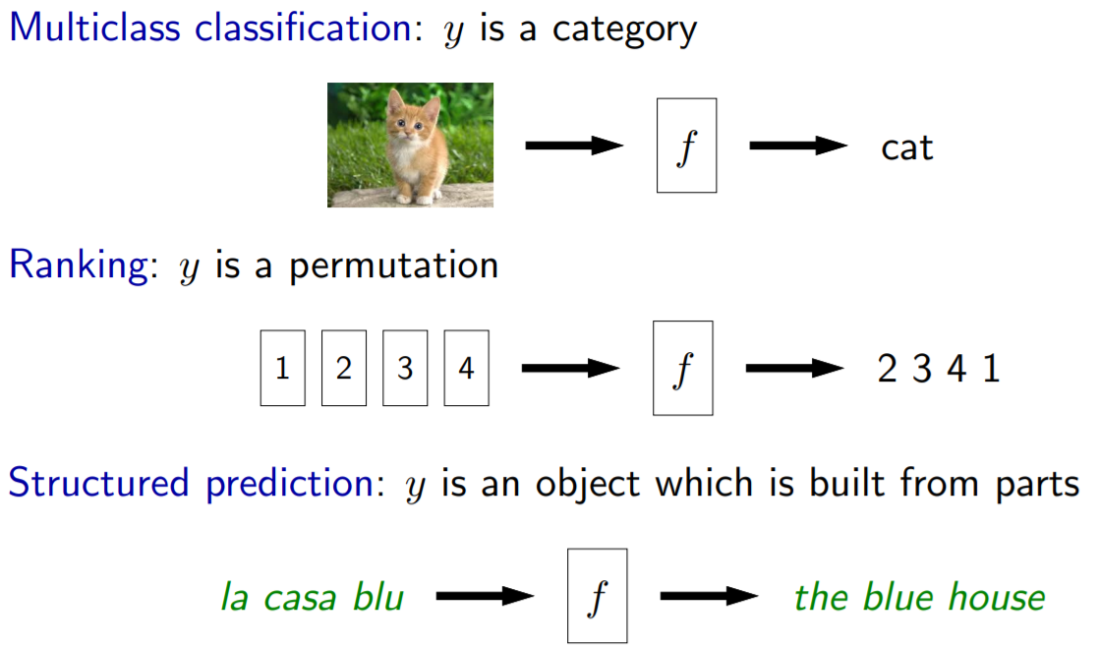
Types of (Supervised) Prediction Tasks

Slide 6
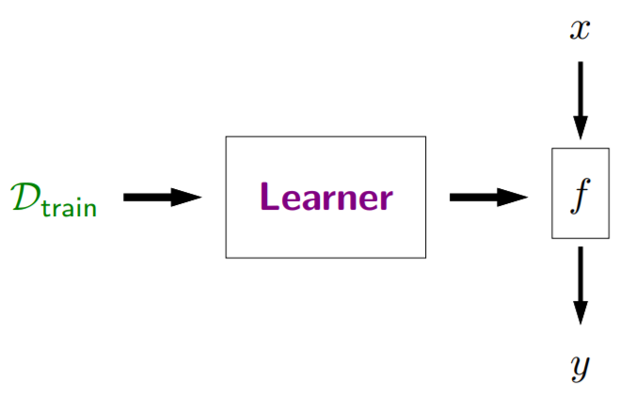
Learning From Examples
Learning is …
Taking the training data D_{train} and producing a predictor f,
Training data for supervised learning:
input-output pair (x, y)
Feature vector

Slide 7
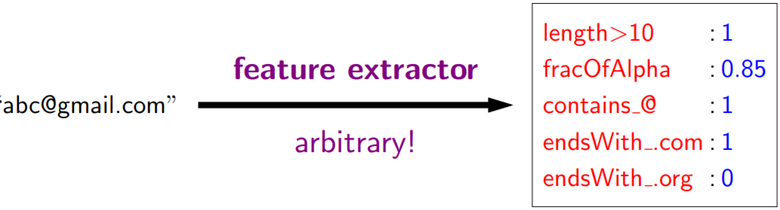
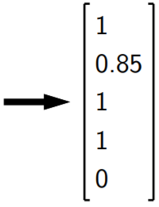
Learning From Examples
Feature extraction is …
An art that requires intuition about the task
To represent the input x as a point in high dimension vector space
Example:
x: an email,
Is it okay to add features which turn out to be irrelevant?
Input: an email
Name-value pairs
Feature vector

Slide 8
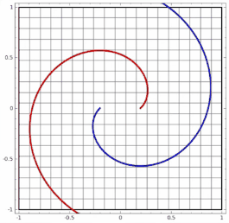
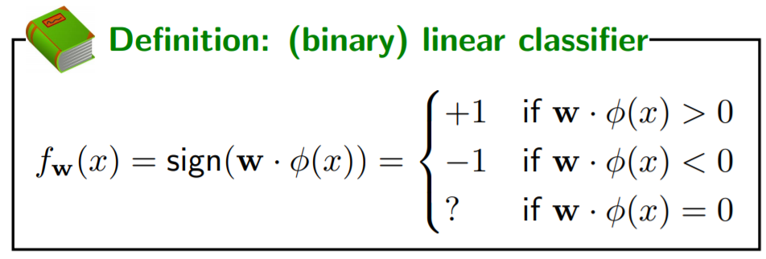
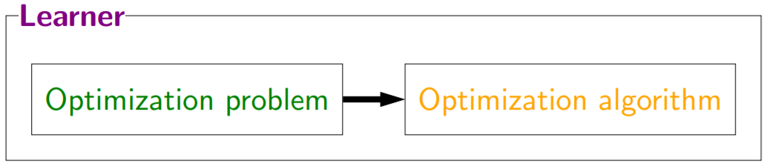
Linear Predictors
For binary classification
defines a hyperplane decision boundary with normal vector w
Feature vector φ(x) ∈ R^{d}
Weight vector w ∈ R^{d}
Find a single predictor f_{w} (specified by the weight vector w)
How?

Slide 9
Score and Margin

Slide 10
Decision Boundary
Roadmap
Geometry:
Binary classifier f_{w} defines a hyperplane decision boundary with normal vector w
R¹ : hyperplane is a point
R² : hyperplane is a line
R³ : hyperplane is a plane

Slide 11
Question

Slide 12

When does a binary classifier error on an example?
ⓘ Start presenting to display the poll results on this slide.

Slide 13
Adjust w Based on errors

Slide 14
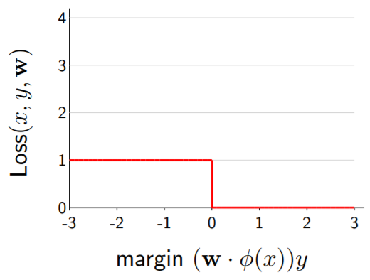
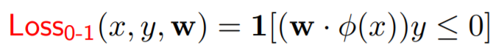
Binary Classification Loss
Recall the binary classifier:

Slide 15
Linear Regression

Slide 16
Regression loss Functions
Single Example Loss. What about many examples?

Slide 17
Minimization Framework
Key idea: need to set w to make global tradeoffs — not every example can be happy
All Loss
Single Loss

Slide 18
More Binary Classification LOSS

Slide 19
請選出關於loss function 正確的敘述?
(複選)
ⓘ Start presenting to display the poll results on this slide.

Slide 20
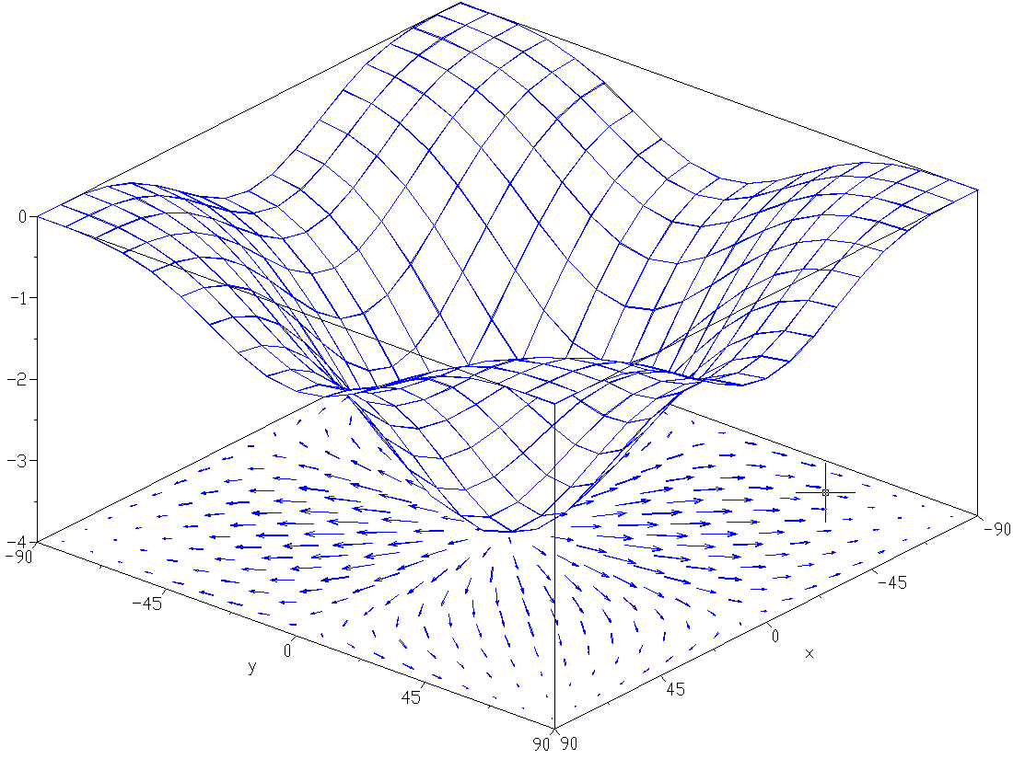
How to optimize? ~Gradient Descent

Slide 21
Stochastic gradient descent

Slide 22
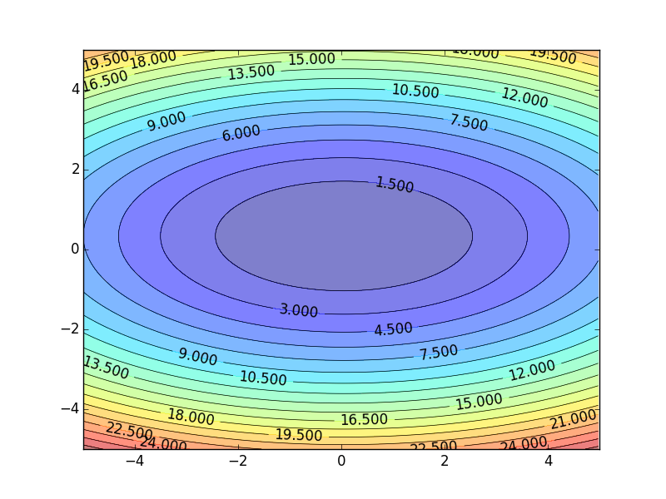
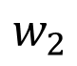
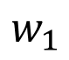
Gradient Descent by H.-Y. Lee@NtU
http://speech.ee.ntu.edu.tw/~tlkagk/courses/ML_2017/Lecture/Gradient%20Descent.pptx
$$w_{2}$$
$$w_{1}$$

Slide 23

請問 Gradient Descent 和 Stochastic Gradient Descent 兩者差別在哪?
ⓘ Start presenting to display the poll results on this slide.

Slide 24
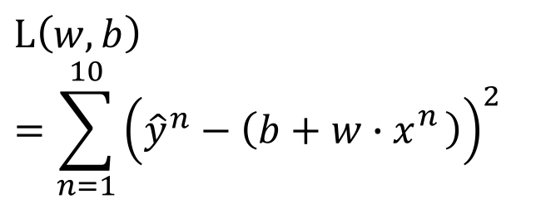
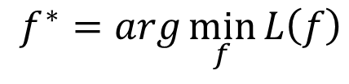
Summary
Step 1: Modeling
Step 2: Goodness of Function
Step 3: Pick the Best Function
Training
Data
A set of function
Model
$$L\left(w,b\right)$$
$$=\sum_{n=1}^{10}{{\left({\hat{y}}^{n}−\left(b+w∙x_{}^{n}\right)\right)}^{2}}$$
Goodness of function f
$$f^{∗}=\arg{\min_{f}{L\left(f\right)}}$$

Slide 25
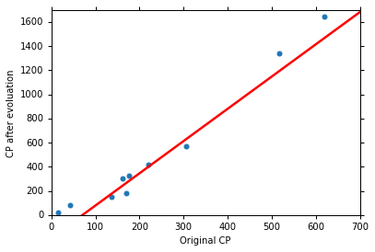
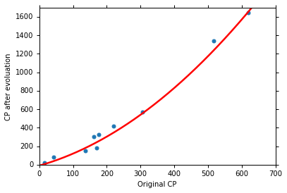
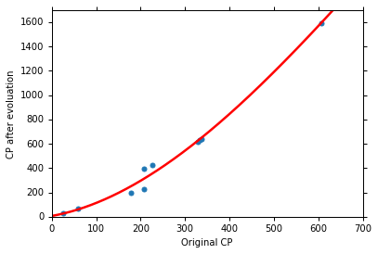
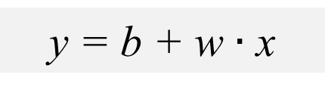
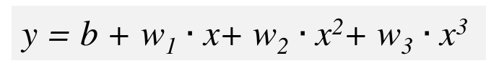
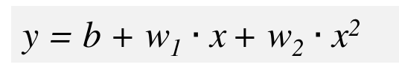
What Kind of Models?
y = b + w $∙$ x
y = b + w₁ $∙$ x + w₂ $∙$ x²
y = b + w₁ $∙$ x+ w₂ $∙$ x²+ w₃ $∙$ x³

Slide 26
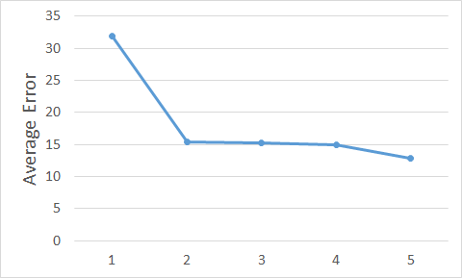
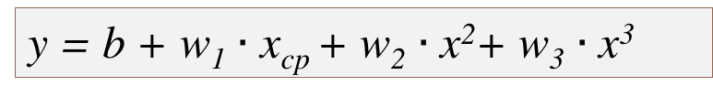
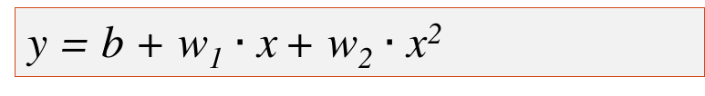
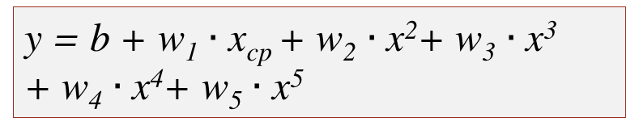
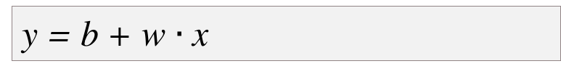
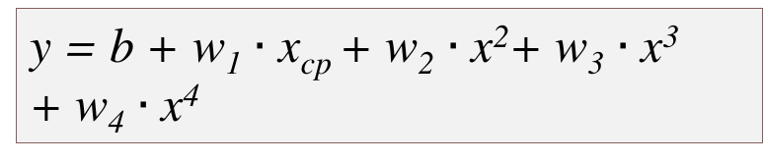
Model Selection
Training Data
1.
y = b + w $∙$ x
2.
y = b + w₁ $∙$ x + w₂ $∙$ x²
3.
y = b + w₁ $∙$ x_{cp} + w₂ $∙$ x²+ w₃ $∙$ x³
y = b + w₁ $∙$ x_{cp} + w₂ $∙$ x²+ w₃ $∙$ x³
+ w₄ $∙$ x⁴
4.
y = b + w₁ $∙$ x_{cp} + w₂ $∙$ x²+ w₃ $∙$ x³
+ w₄ $∙$ x⁴+ w₅ $∙$ x⁵
A more complex model yields lower error on training data.
5.
However, the testing error may increase

Slide 27
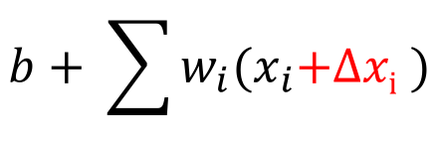
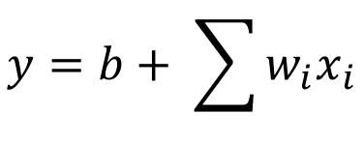
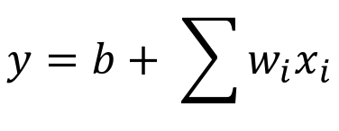
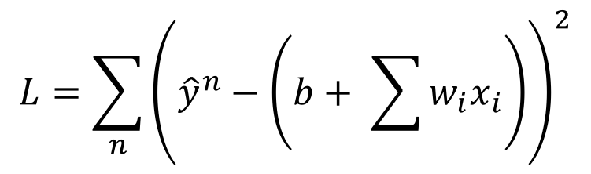

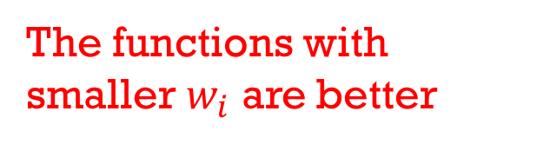
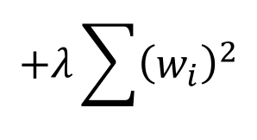
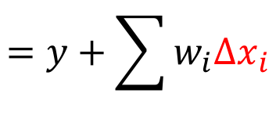
Back to step 2: Regularization
$$y=b+ \sum{w_{i}x_{i}}$$
The functions with smaller $w_{i}$ are better
$$L=\sum_{n}{{\left({\hat{y}}^{n}−\left(b+ \sum{w_{i}x_{i}}\right)\right)}^{2}}$$
$$+λ\sum{{\left(w_{i}\right)}^{2}}$$
We believe smoother function is more likely to be correct
$$y=b+ \sum{w_{i}x_{i}}$$
Smaller $w_{i}$ means …
smoother
$$b+ \sum{w_{i}{(x}_{i}\text{+}\text{Δ}\text{x}\text{i} )}$$
$$=y+\sum{w_{i}Δx_{i}}$$

Slide 28
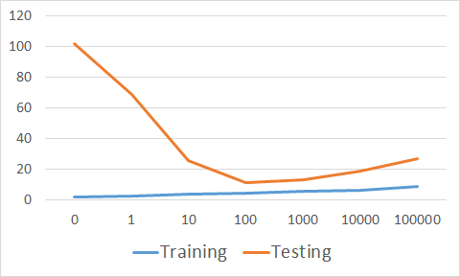
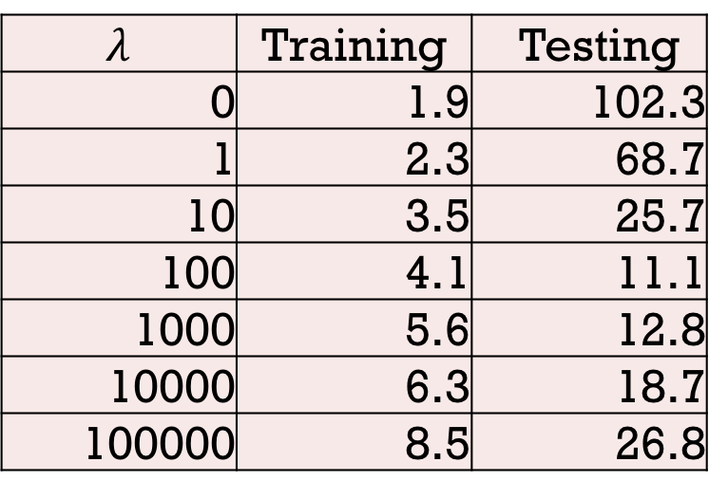
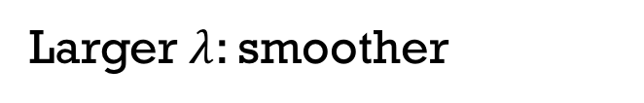
Regularization
$$λ$$ | Training | Testing
0 | 1.9 | 102.3
1 | 2.3 | 68.7
10 | 3.5 | 25.7
100 | 4.1 | 11.1
1000 | 5.6 | 12.8
10000 | 6.3 | 18.7
100000 | 8.5 | 26.8
λ
Larger $λ$: smoother
We prefer smooth function, but don’t be too smooth.

Slide 29

Audience Q&A Session
ⓘ Start presenting to display the audience questions on this slide.

